Slide 1


Slide 2
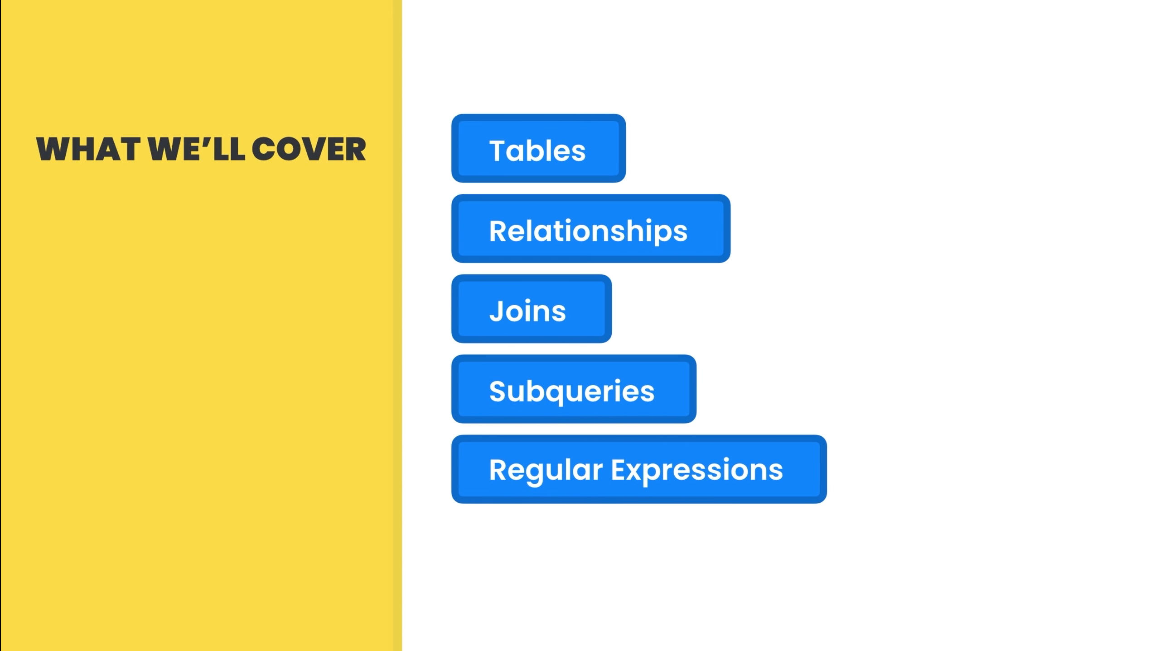

Slide 3


Slide 4


Slide 5
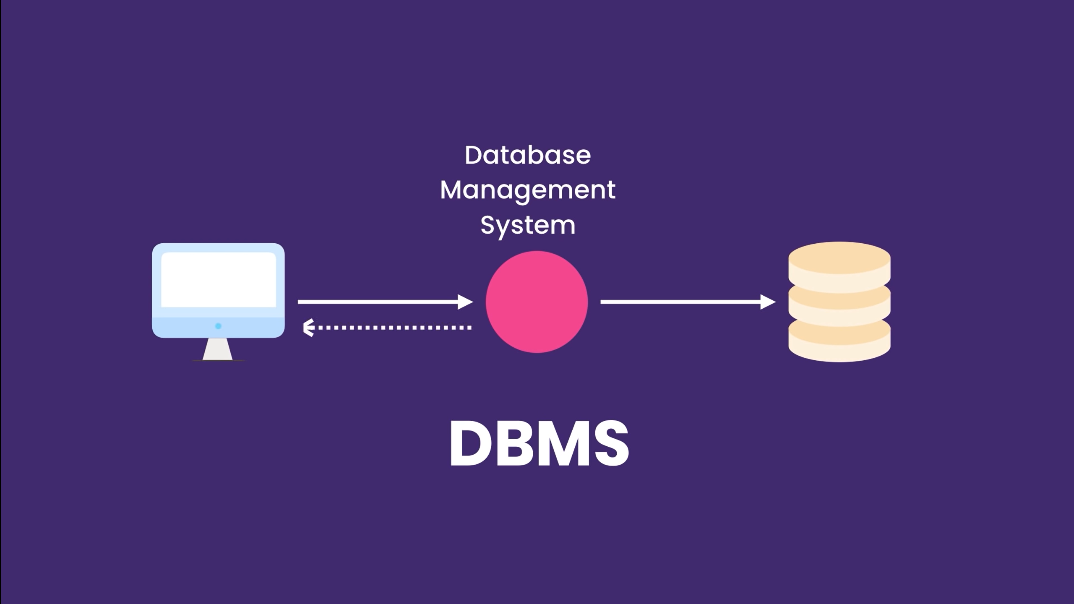

Slide 6


Slide 7
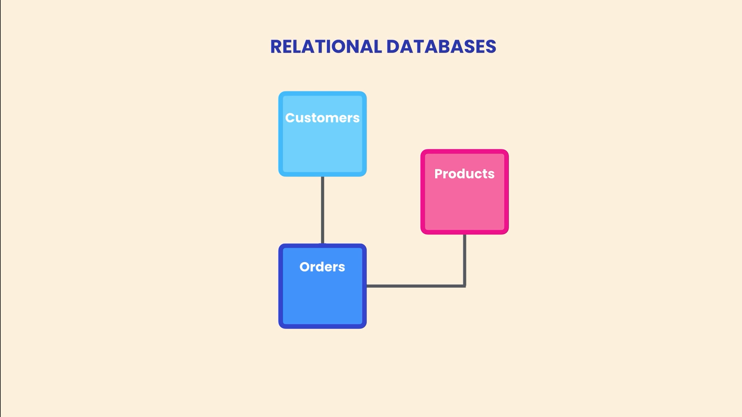

Slide 8
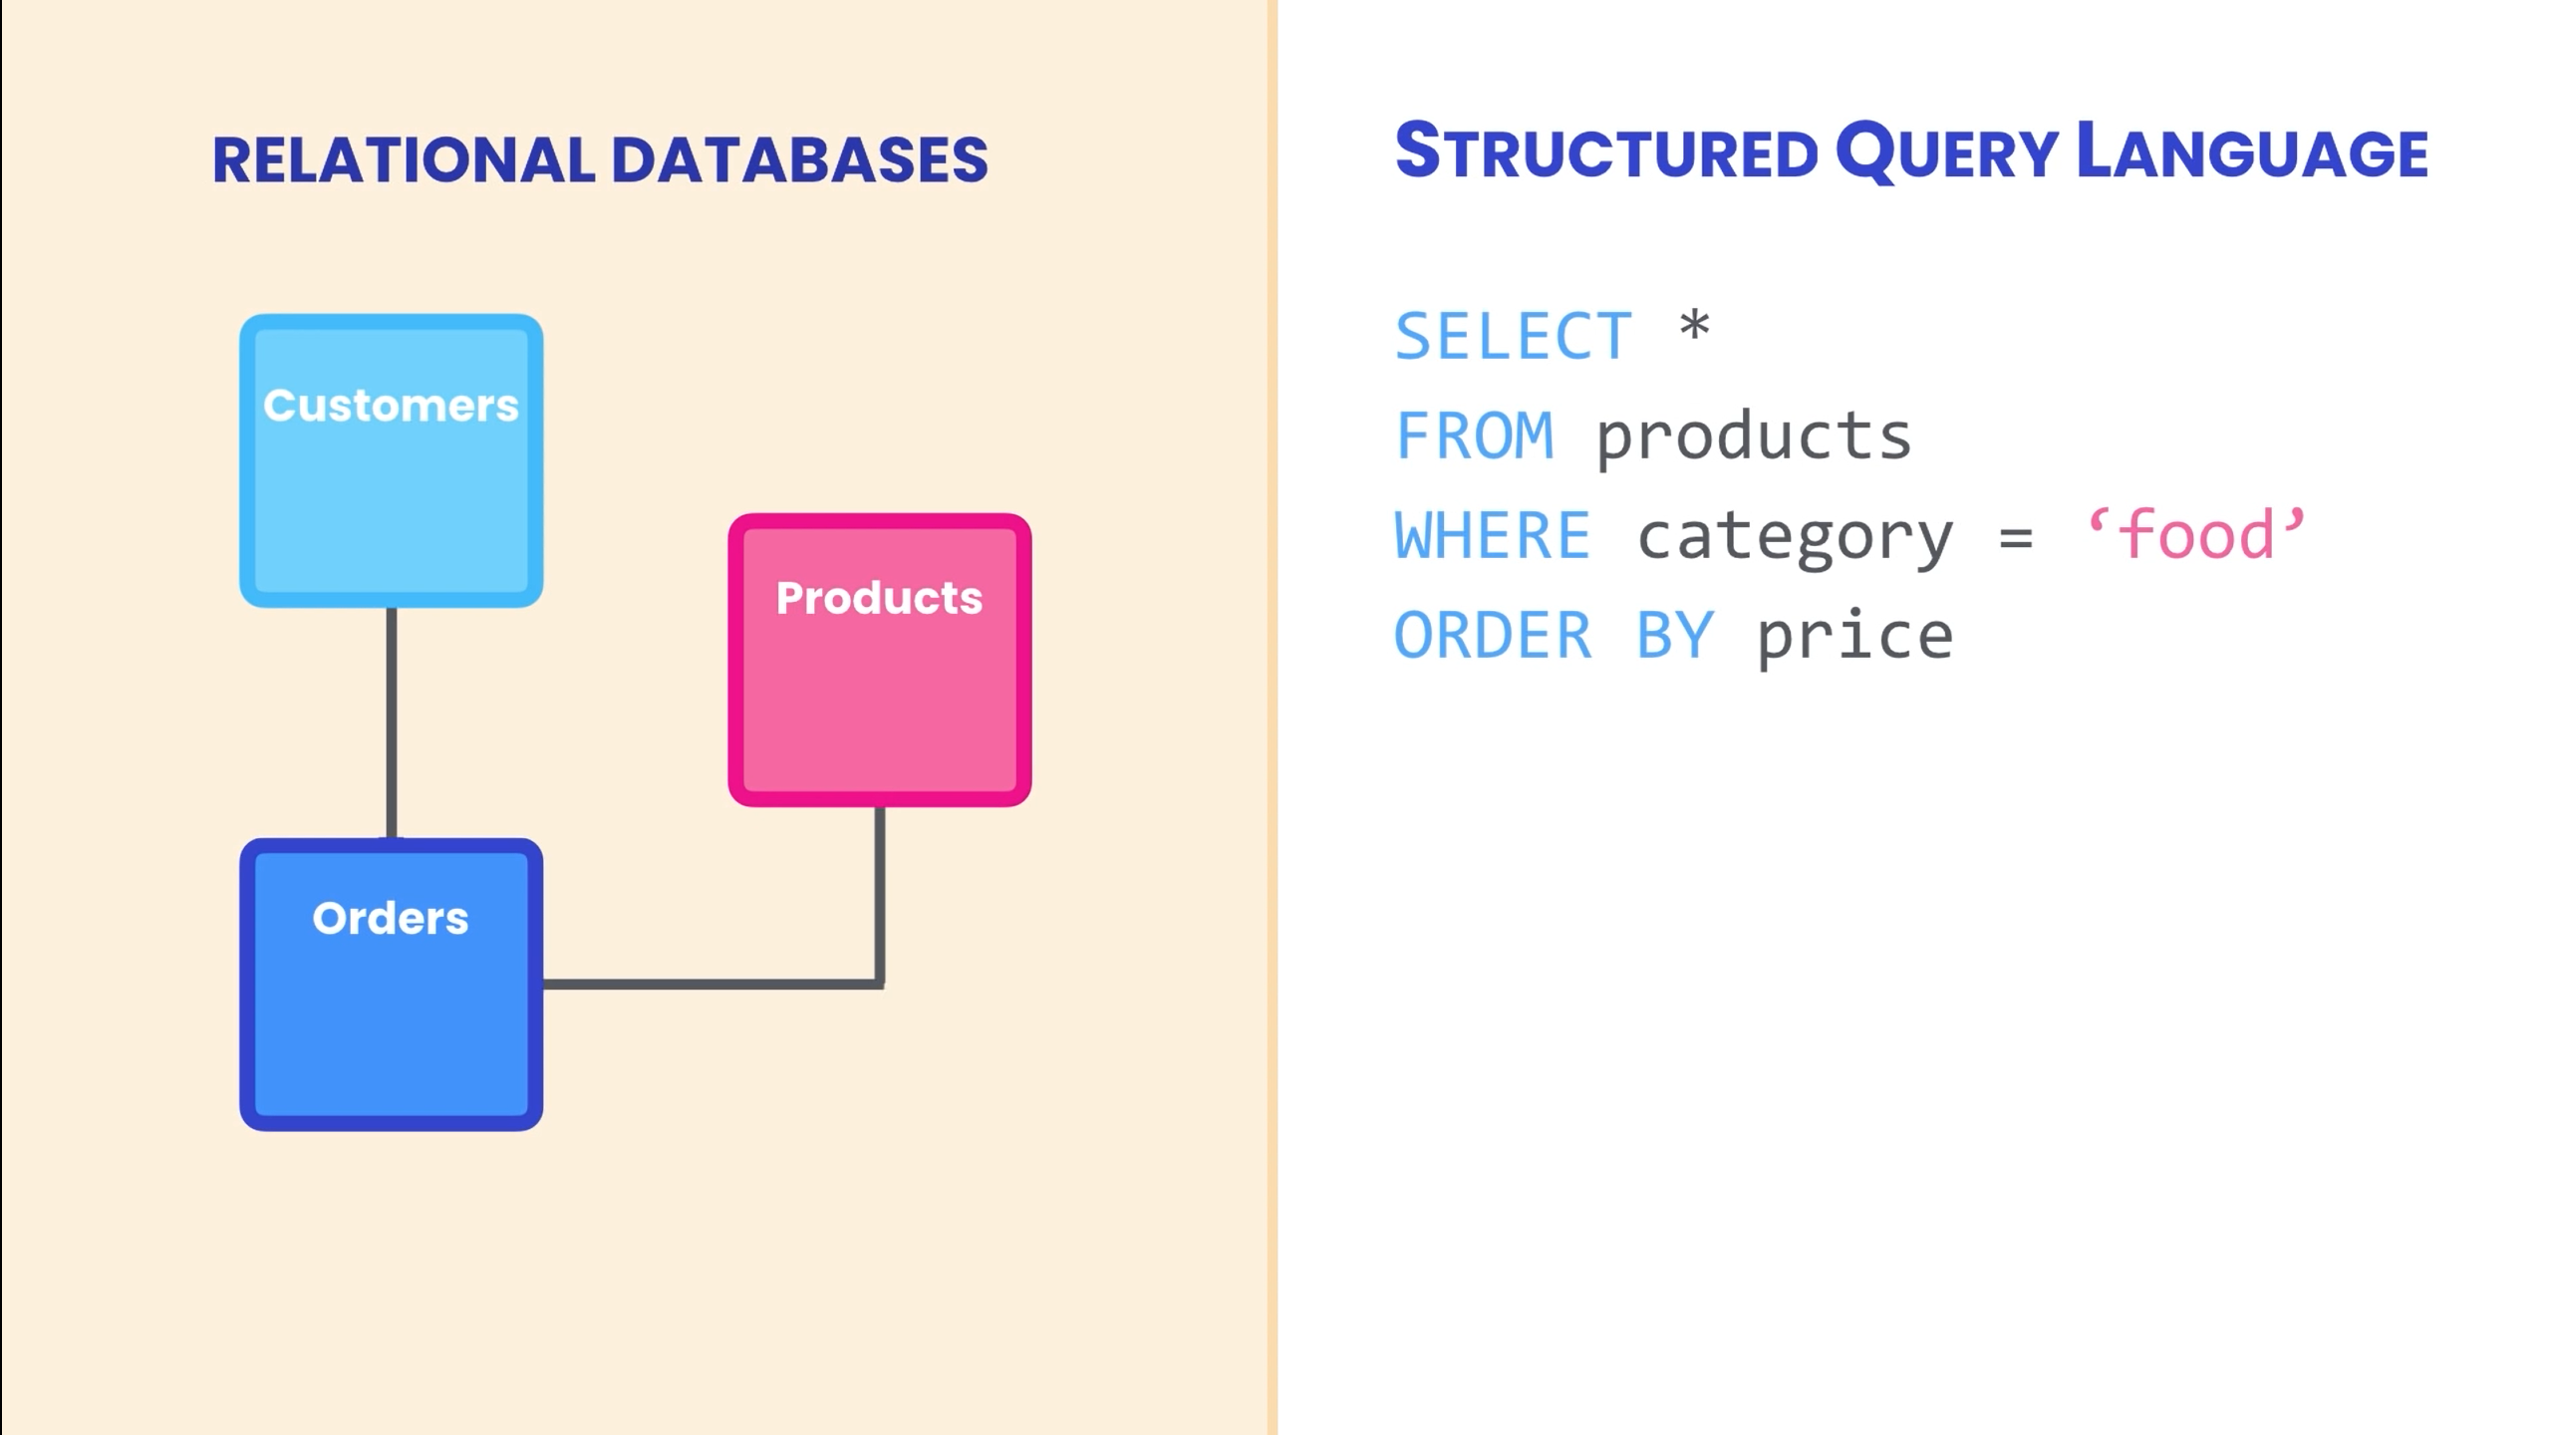

Slide 9
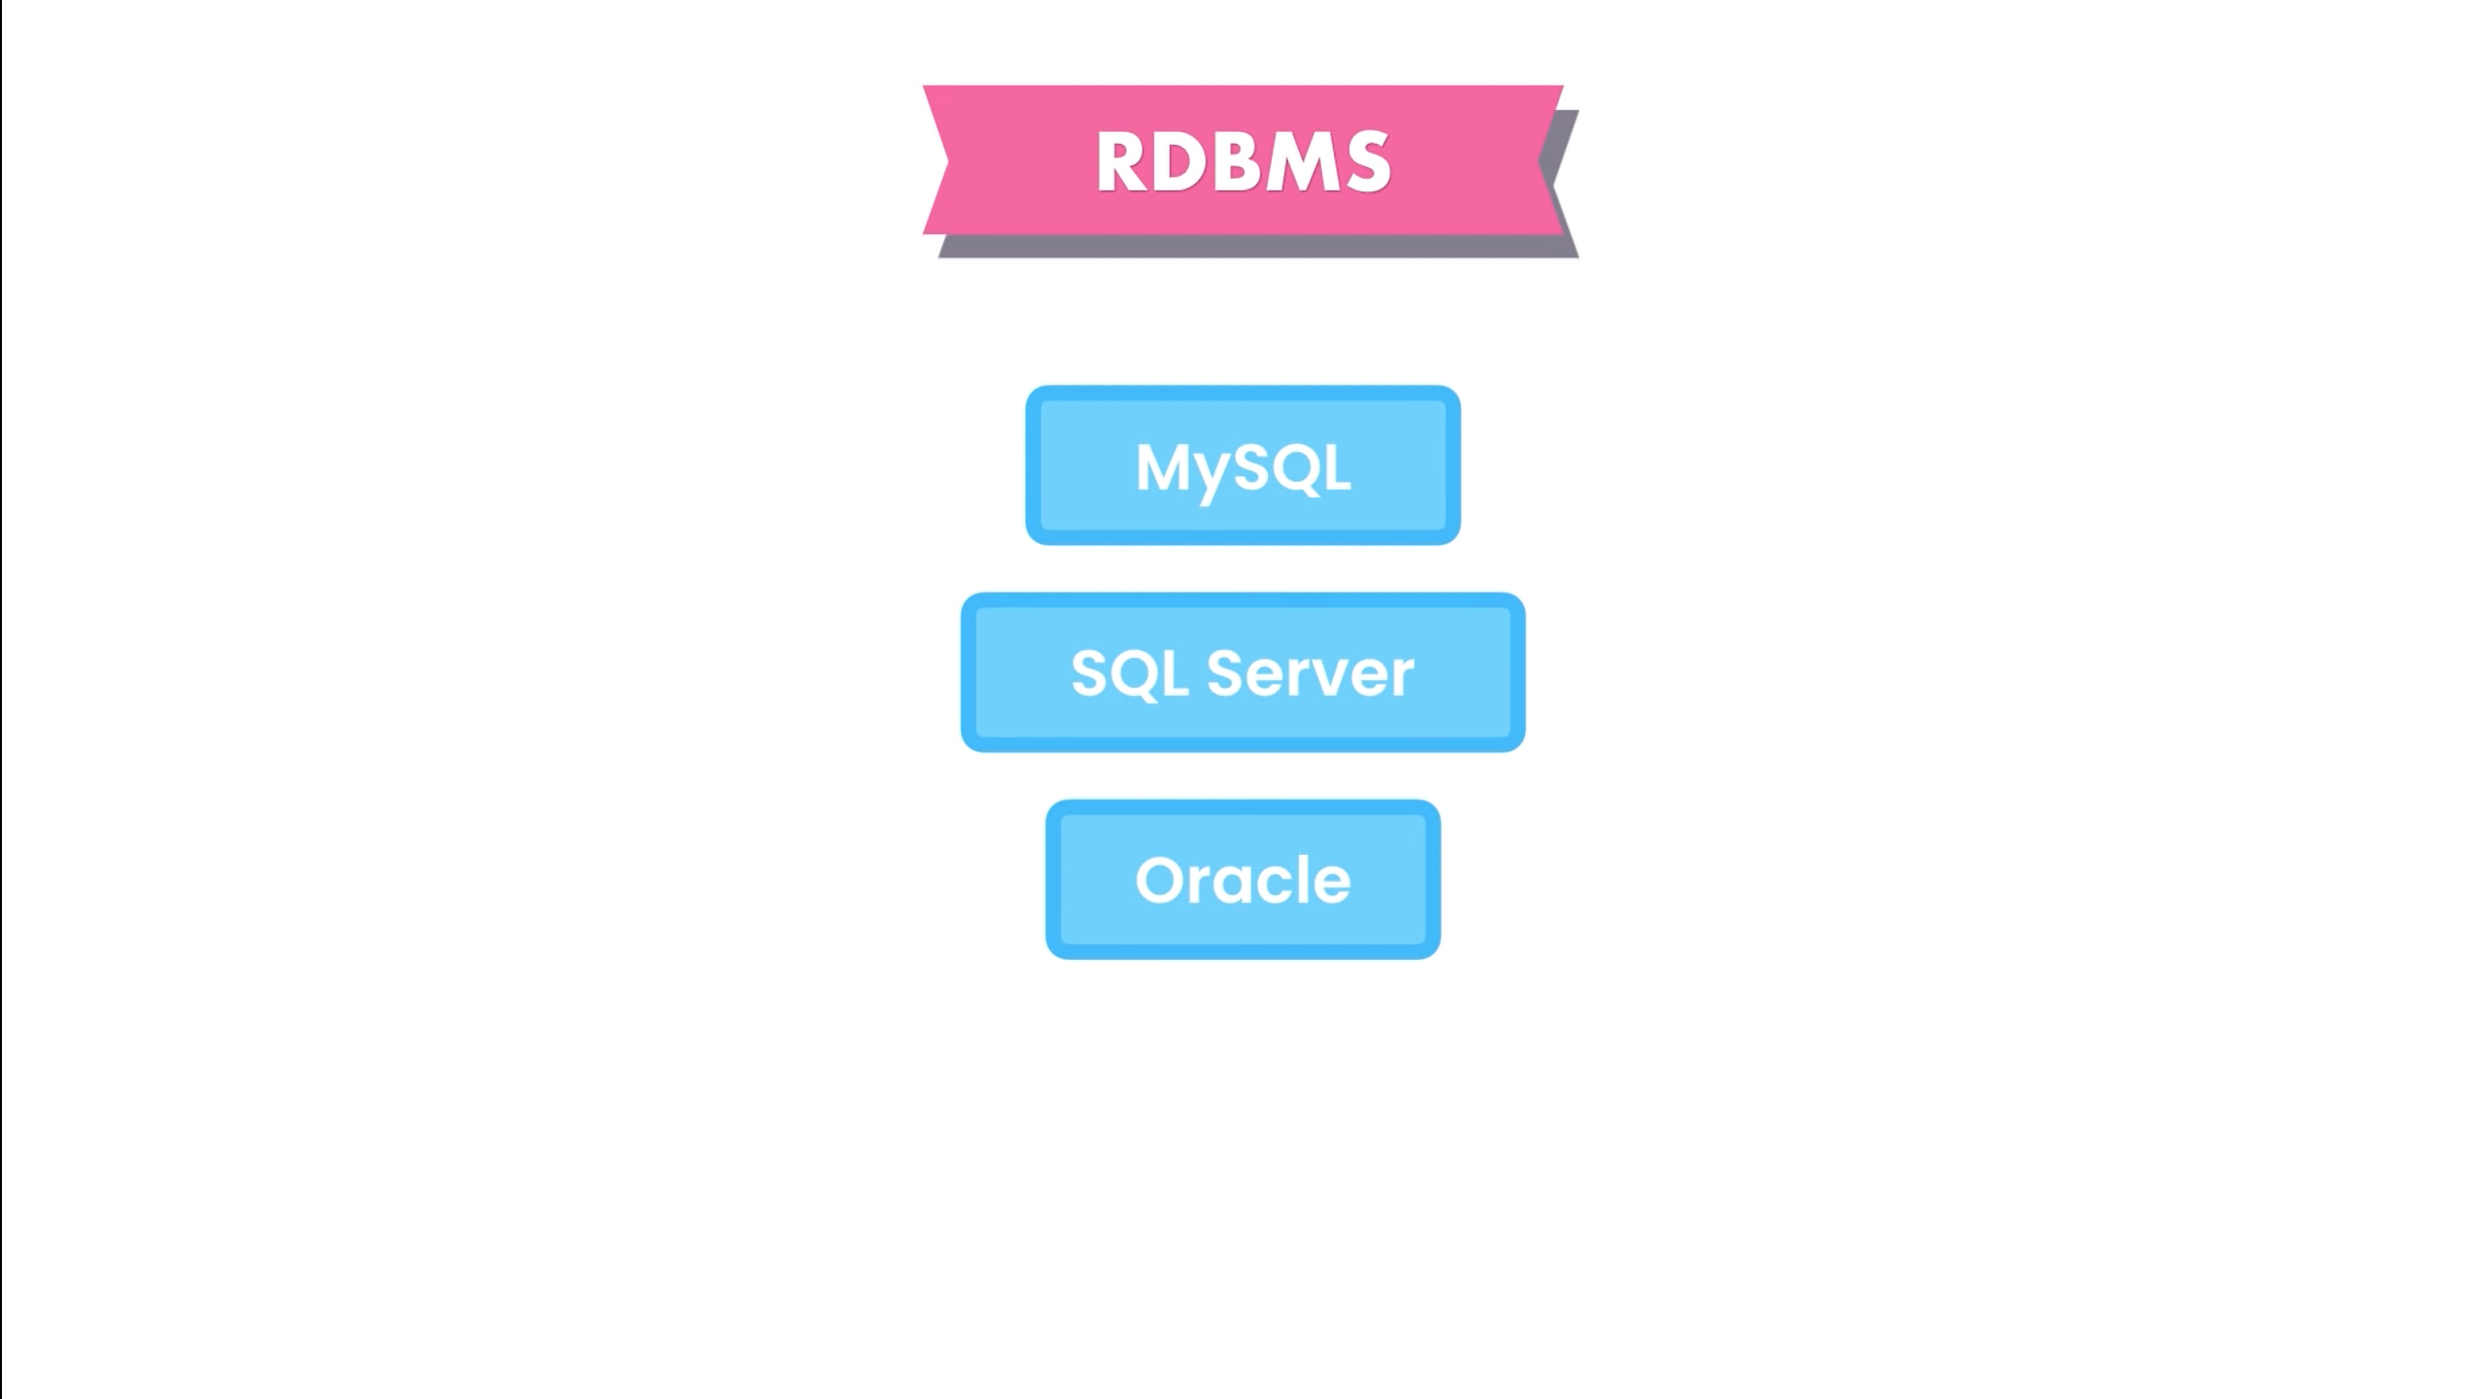

Slide 10


Slide 11


Slide 12


Slide 13


Slide 14


Slide 15
SQL ARCHITECTURE

Slide 16
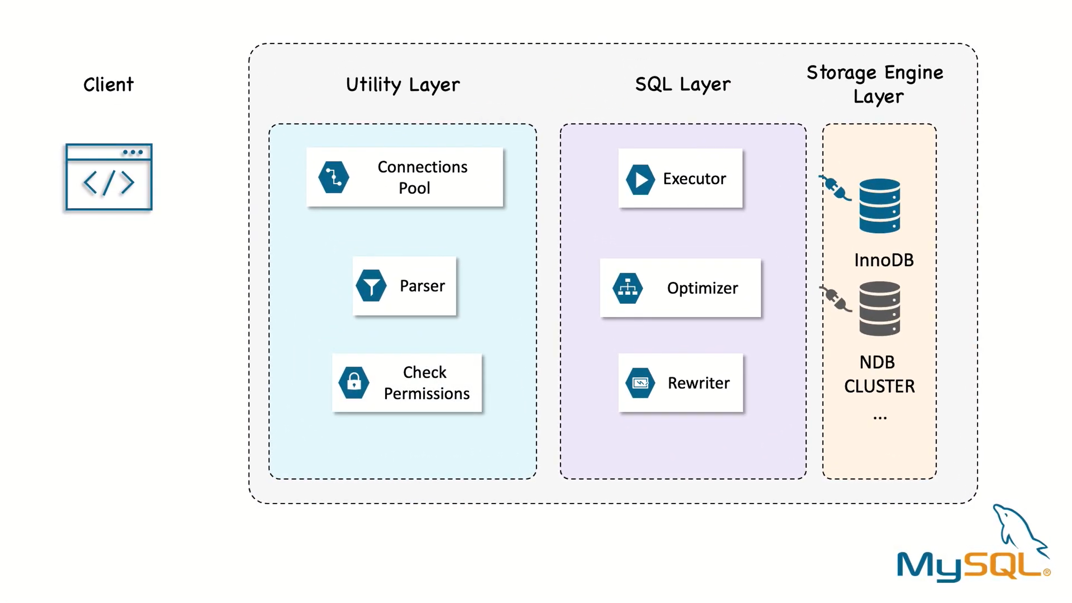

Slide 17
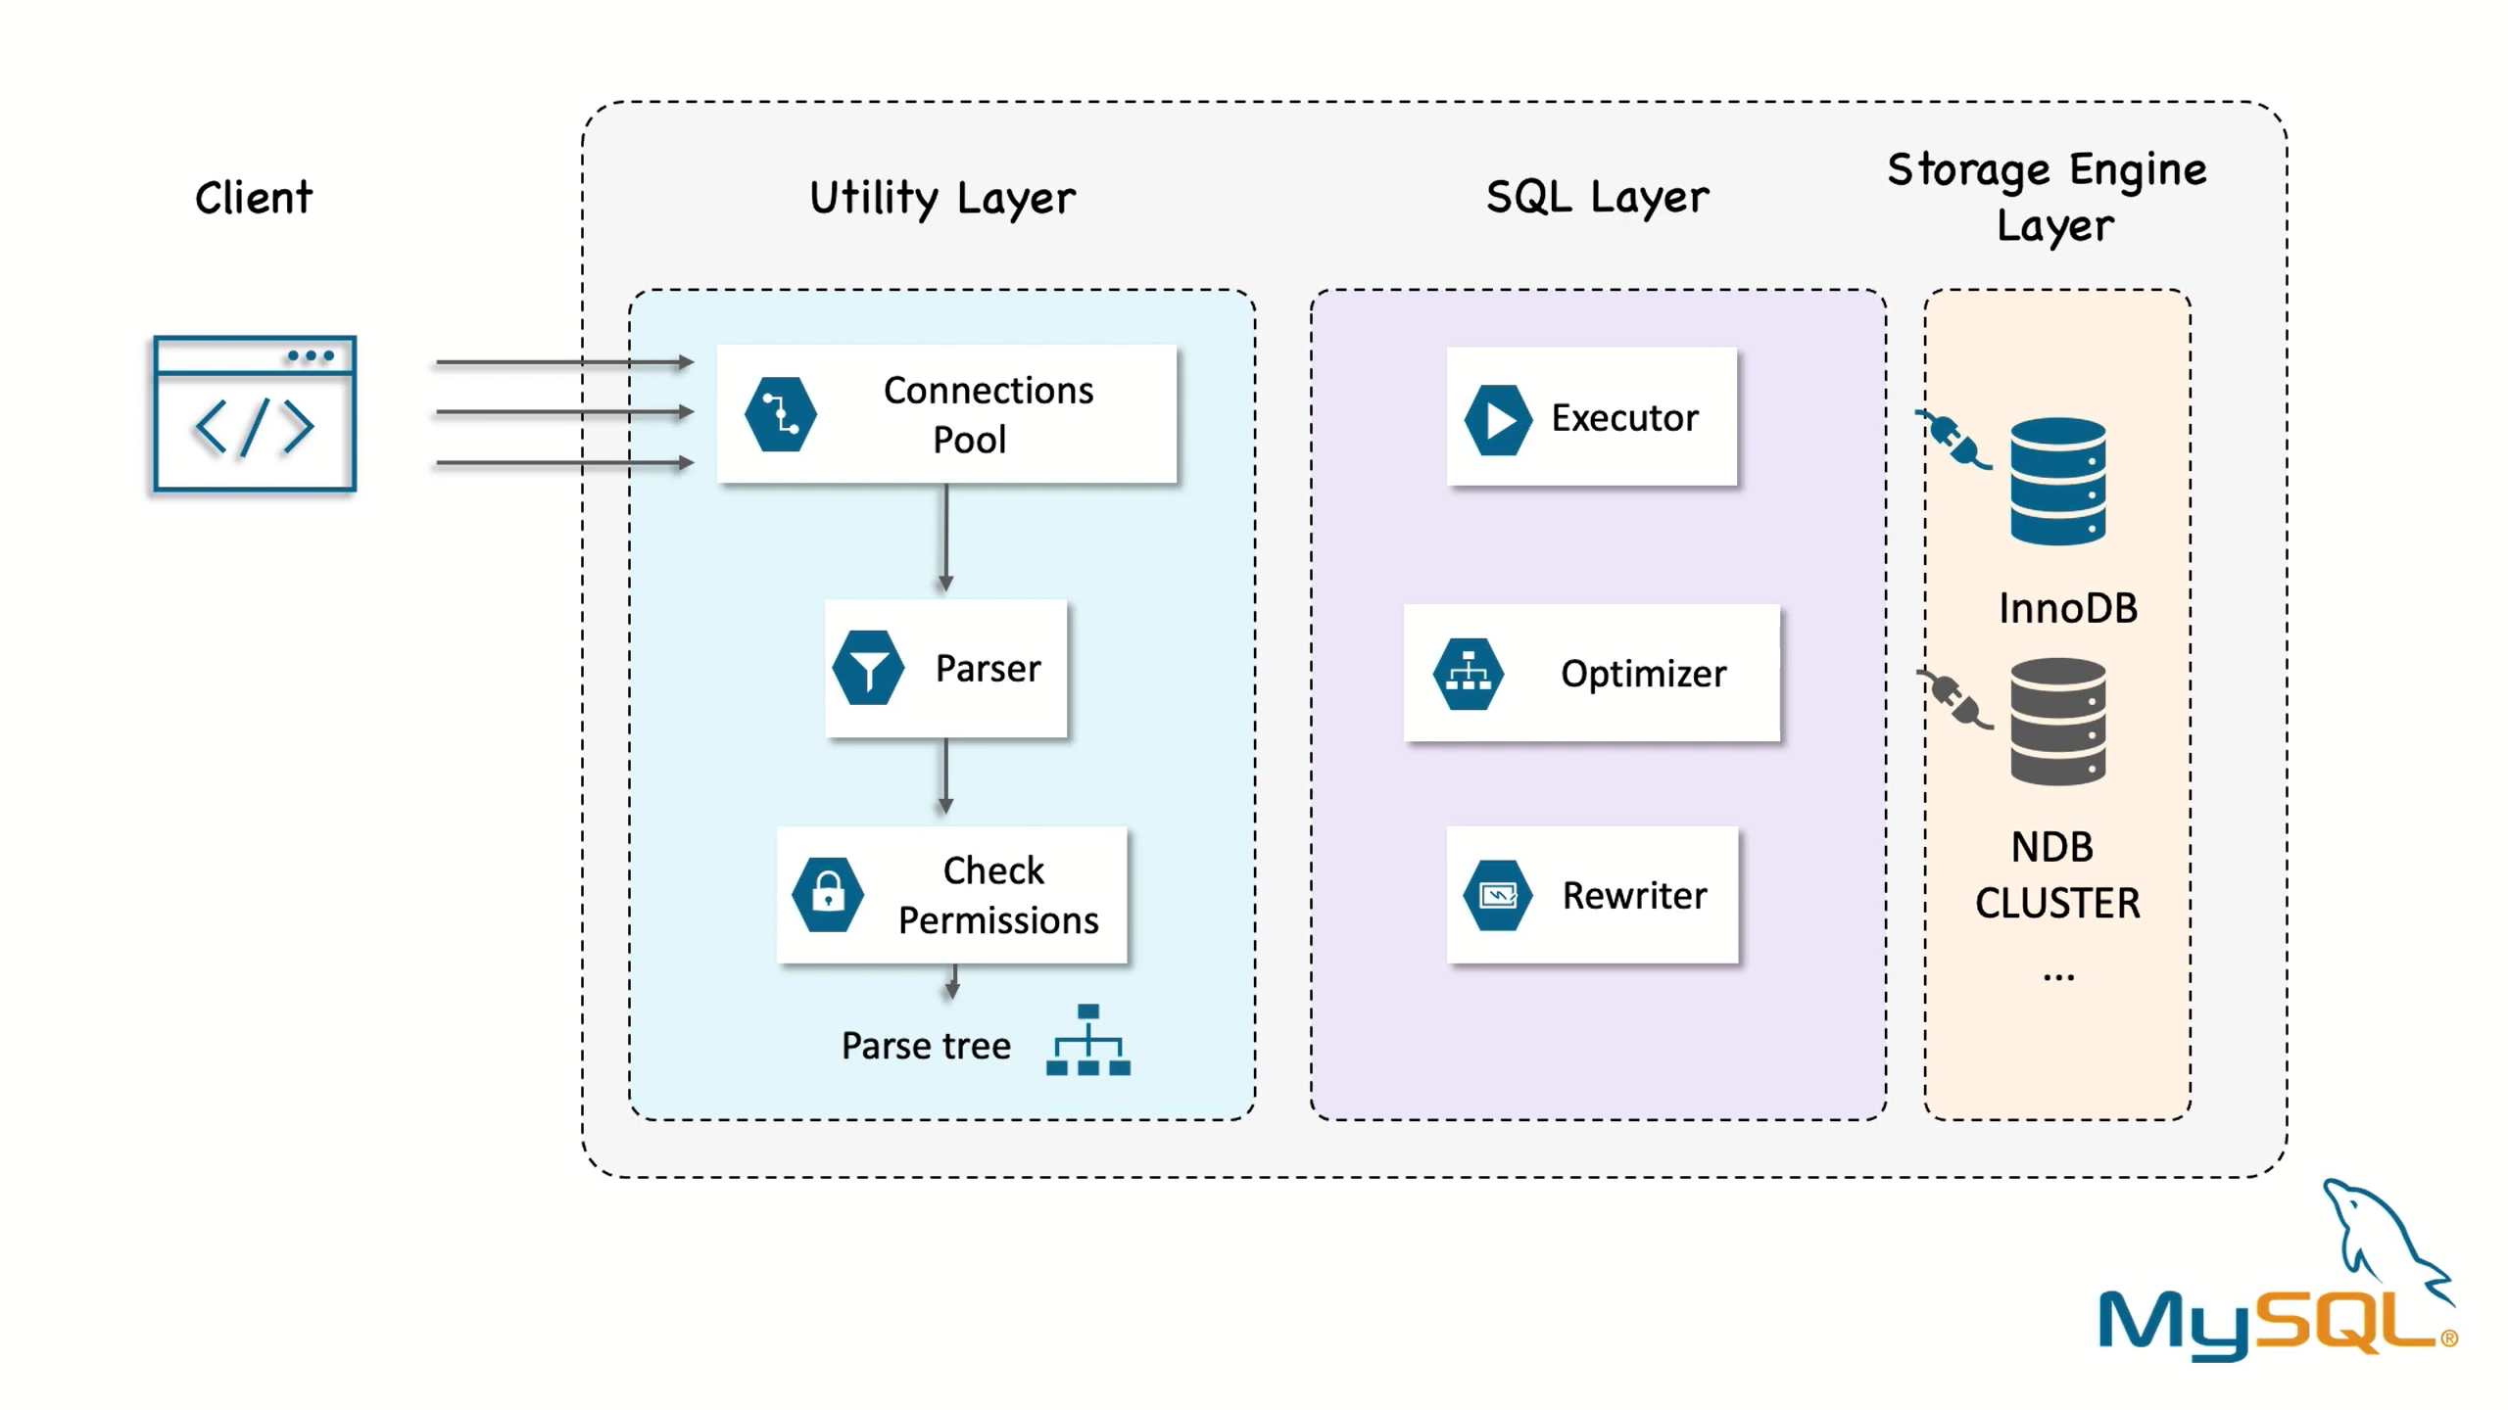

Slide 18
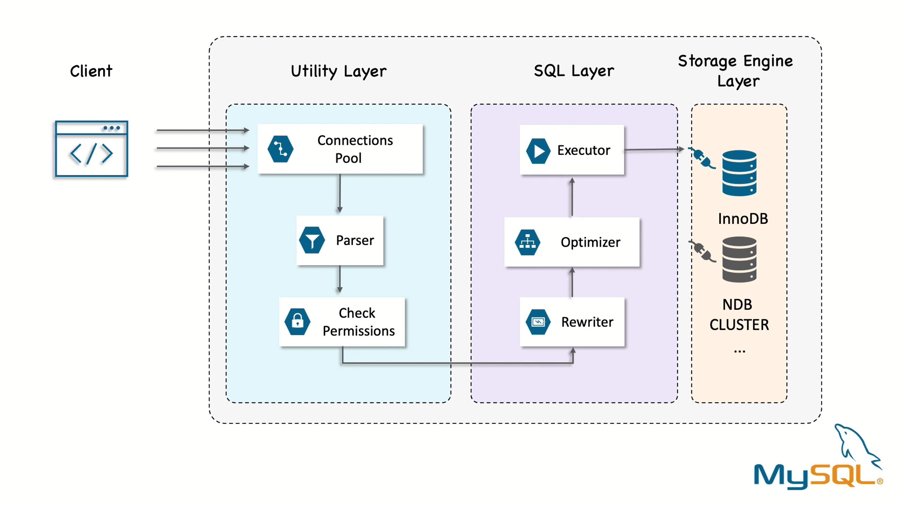

Slide 19
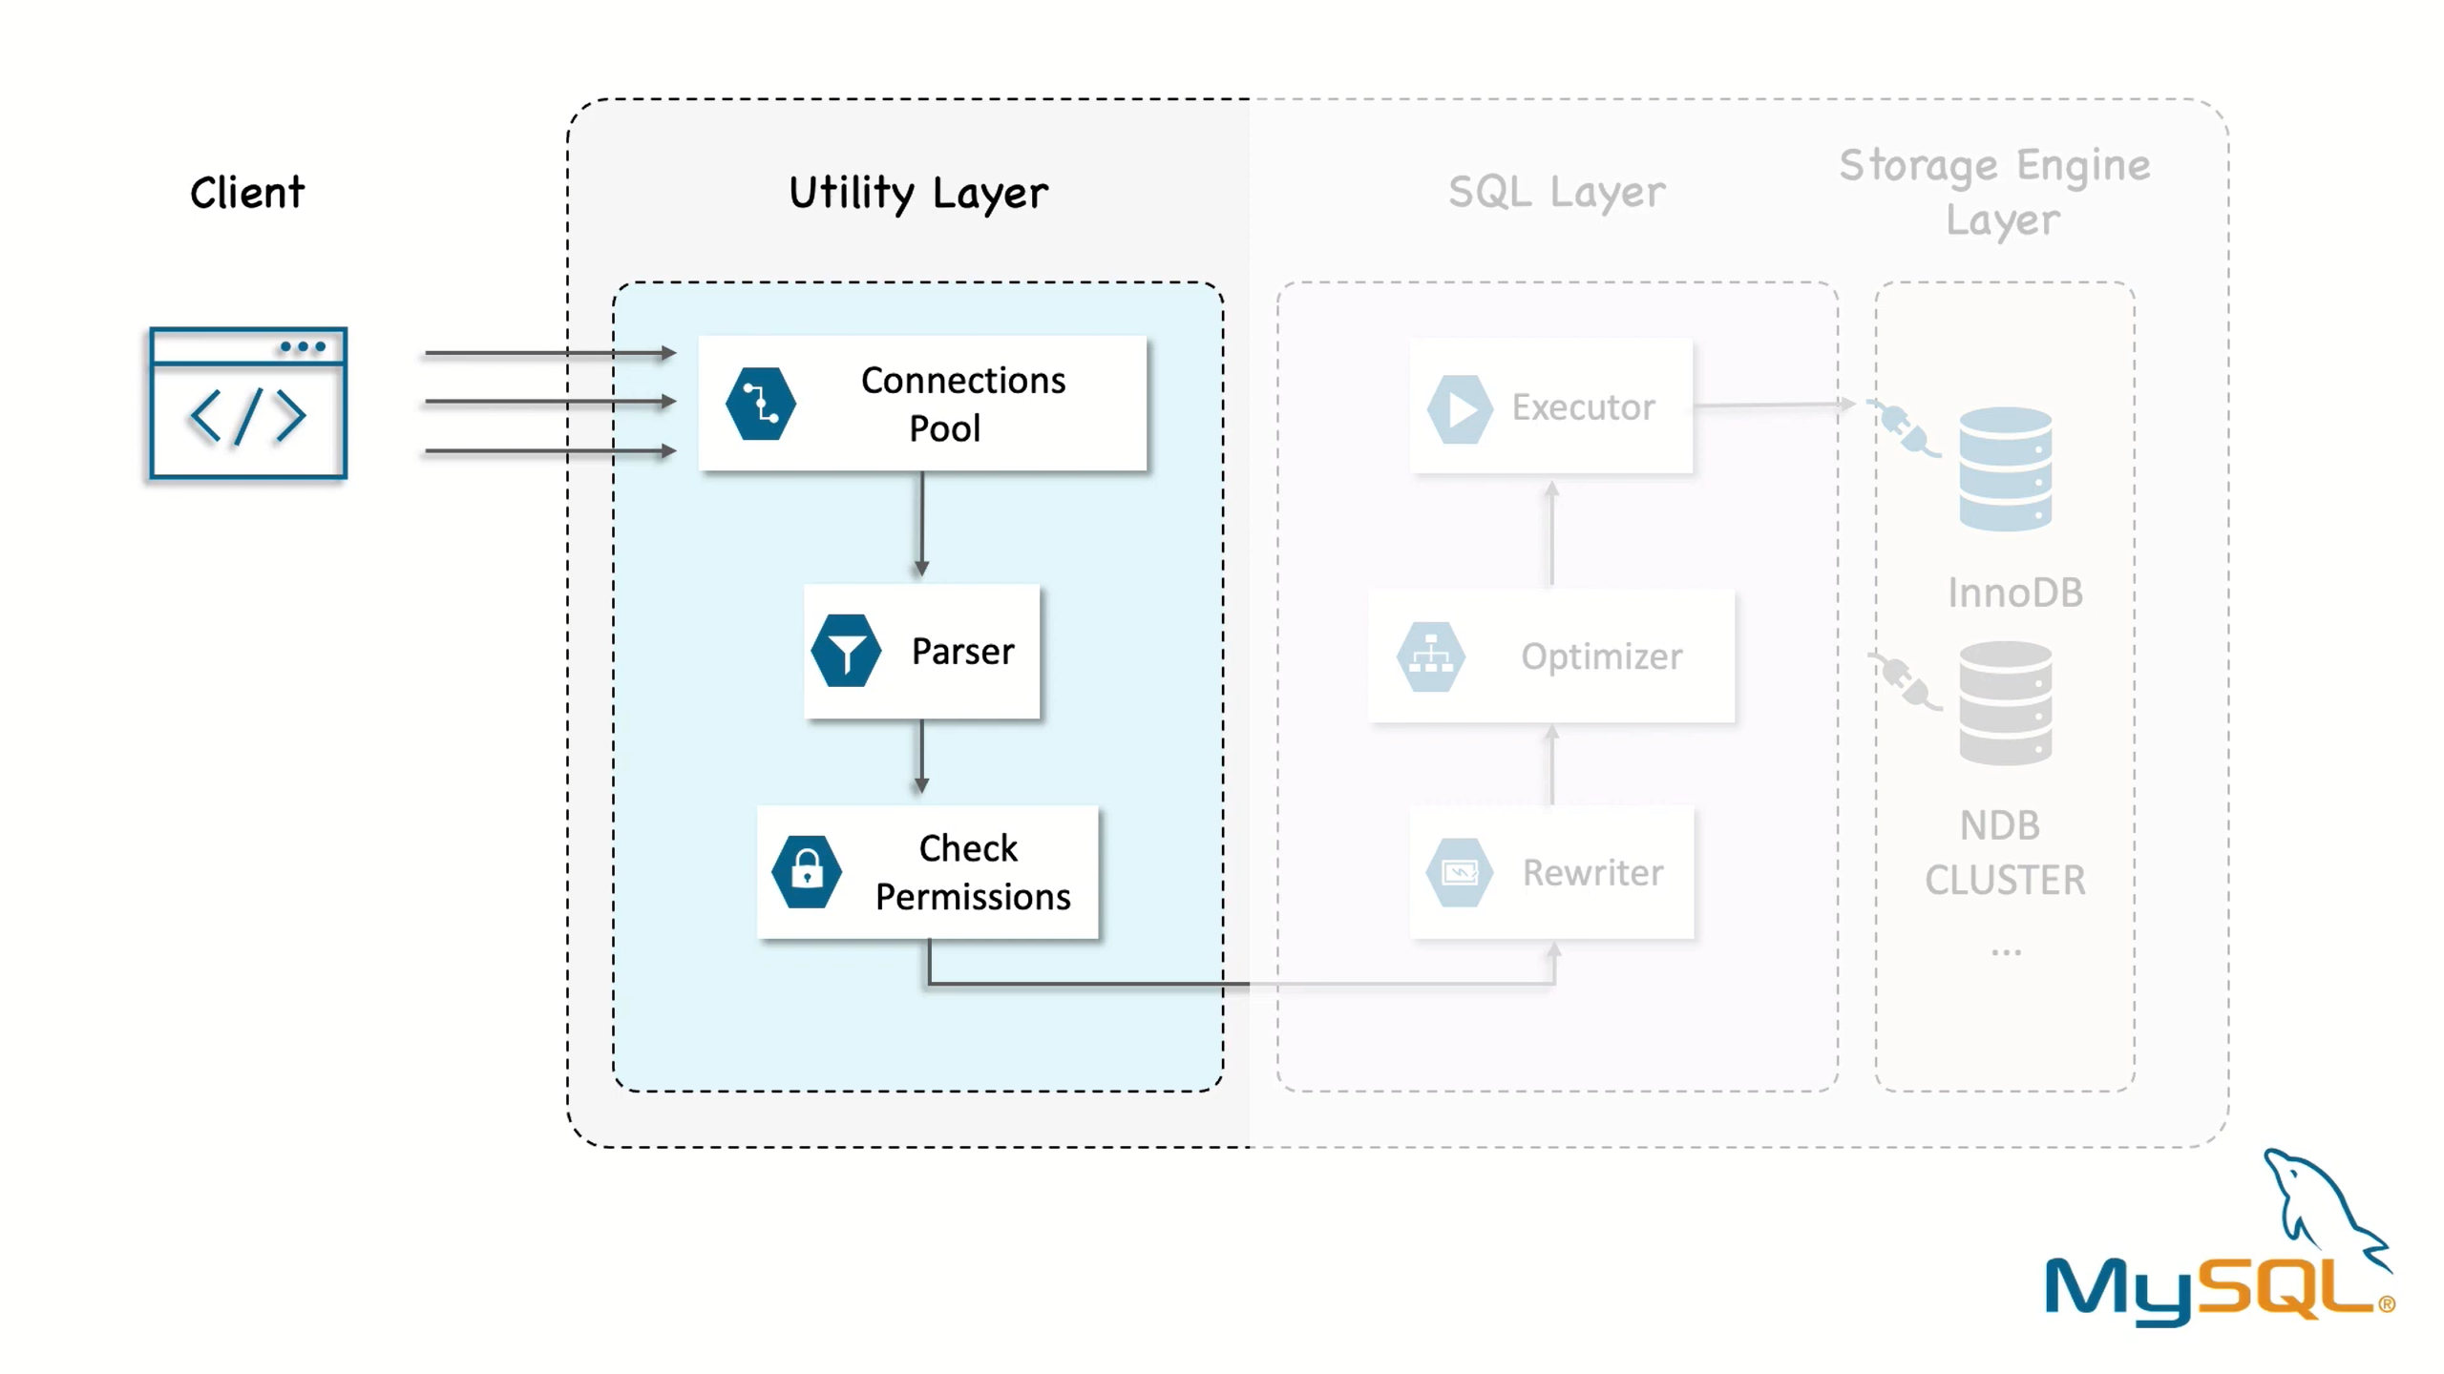

Slide 20
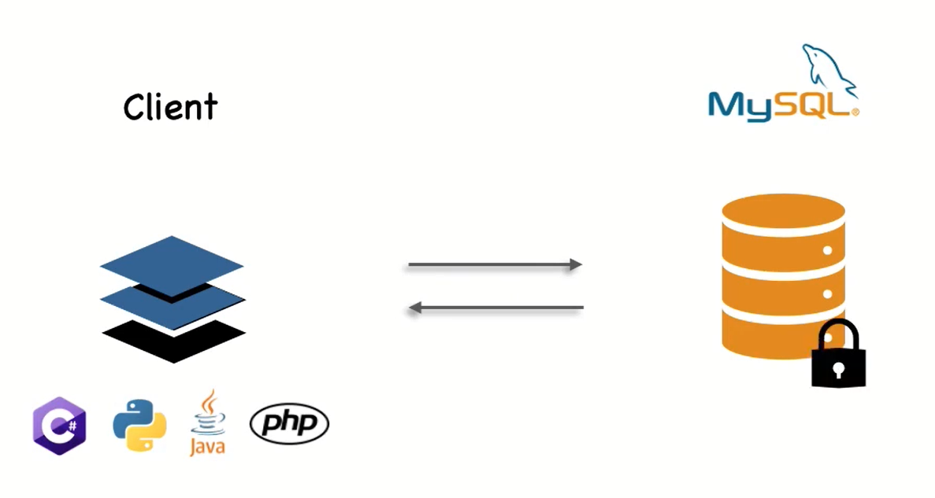

Slide 21
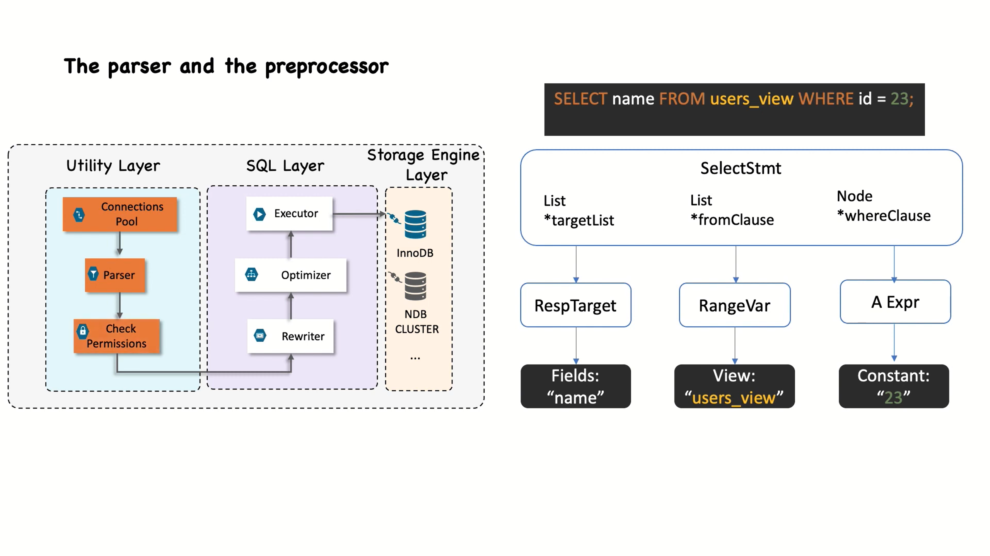

Slide 22
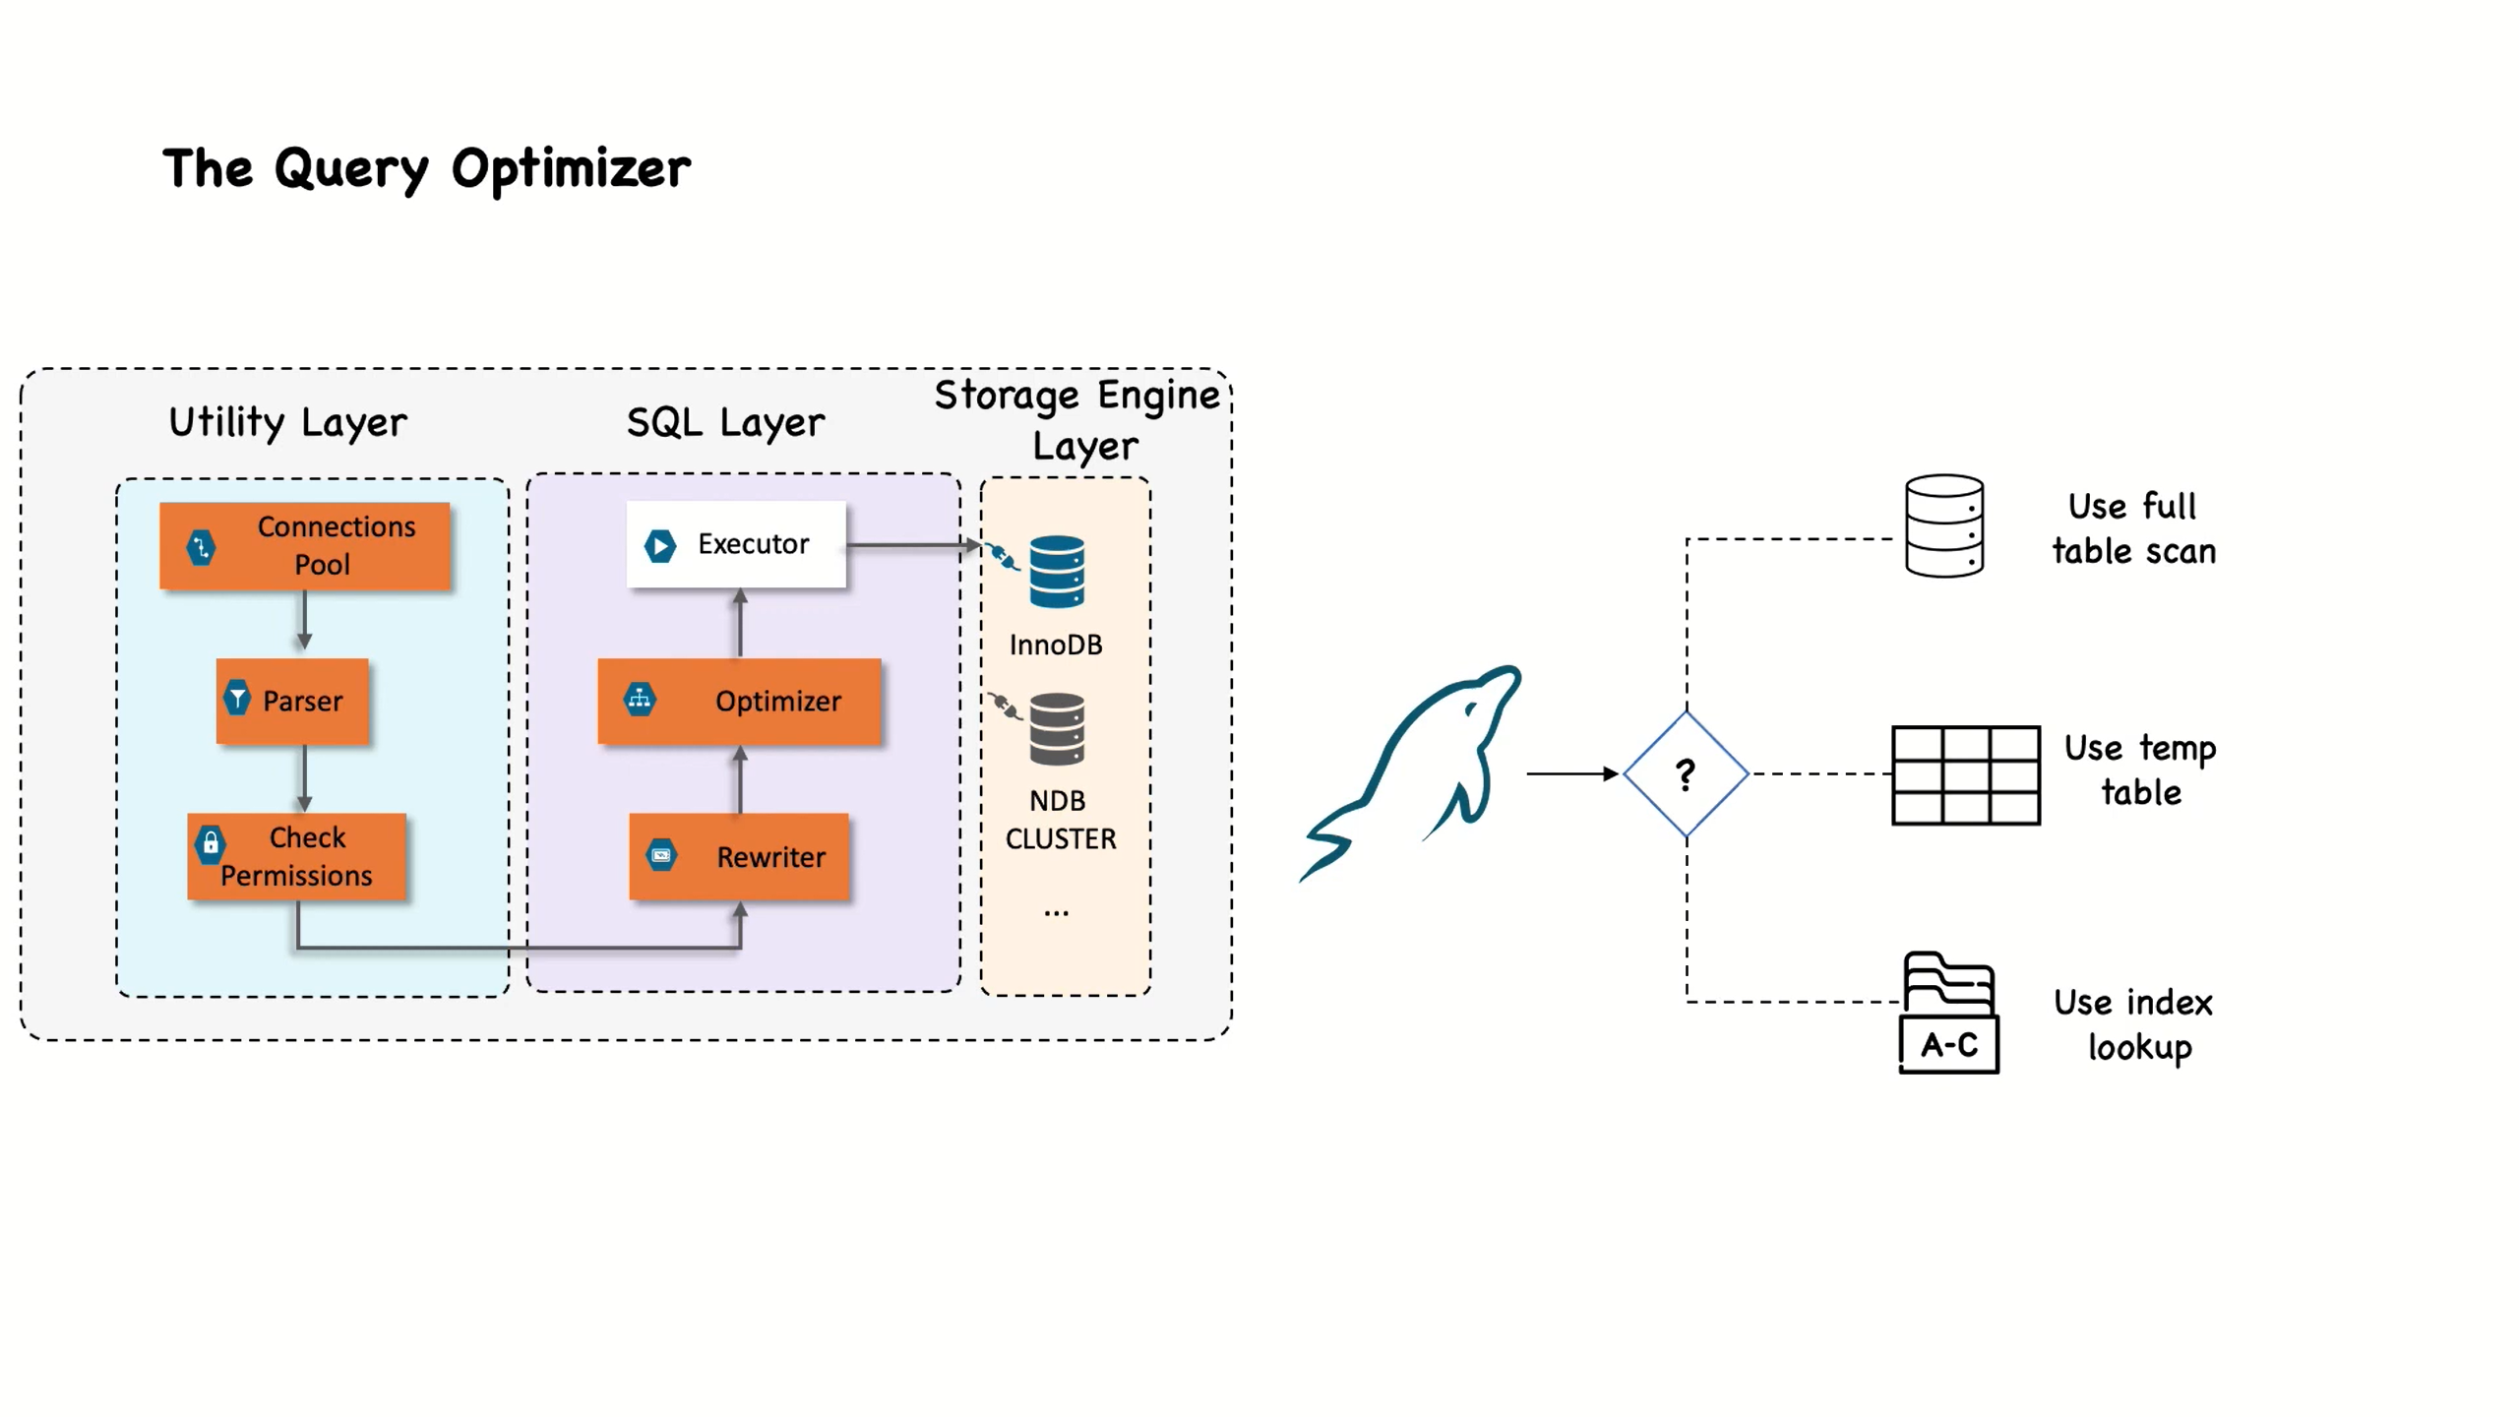

Slide 23
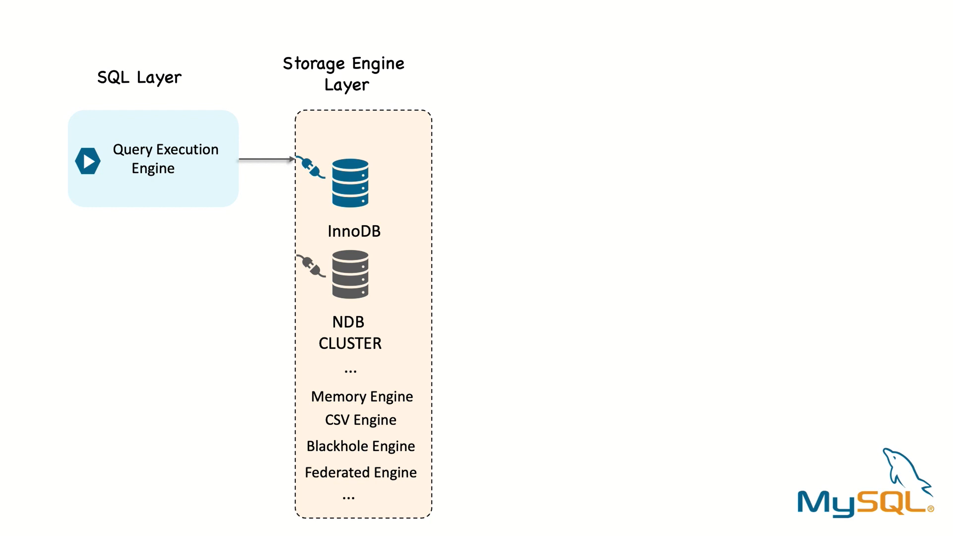

Slide 24


Slide 25
Environment Setup
MySQL Installation
Mysql.com → Downloads → MySQL community downloads → MySQL installer for Windows

Slide 26
Data Types
Numeric
String
Date and Time…

Slide 27


